Slide 1
Edge Detection
Edge Detection is a technique used to identify the boundaries of objects within images.
It helps in simplifying the image data by reducing the amount of information to be processed while preserving the structural properties of the image.
This simplification is essential for various image analysis tasks, including object recognition, segmentation, and image enhancement.

Slide 2
Basic Concepts of Edge Detection
Edge detection methods can be broadly categorized into two types
Gradient-based methods
Second-order derivative methods

Slide 3
Gradient:
An image gradient is a directional change in the intensity or color in an image.
The gradient of the image is one of the fundamental building blocks in image processing.
Mathematically, the gradient of a two-variable function at each image point is a 2D vector with the components given by the derivatives in the horizontal and vertical directions.
At each image point, the gradient vector points in the direction of largest possible intensity increase, and the length of the gradient vector corresponds to the rate of change in that direction.

Slide 4
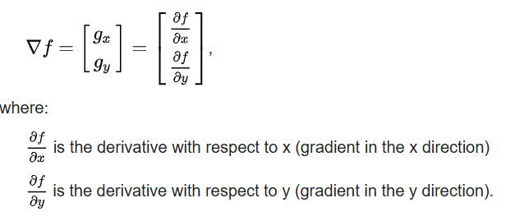


The gradient of an image is a vector of its partials,
The gradient direction can be calculated by the formula:
the magnitude is given by

Slide 5
Gradient-Based Methods
Gradient-based methods detect edges by looking for the maximum and minimum in the first derivative of the image.
The gradient of an image measures the change in intensity at a point.
The most common gradient-based operators are the
Sobel
Prewitt
Roberts Cross operators

Slide 6
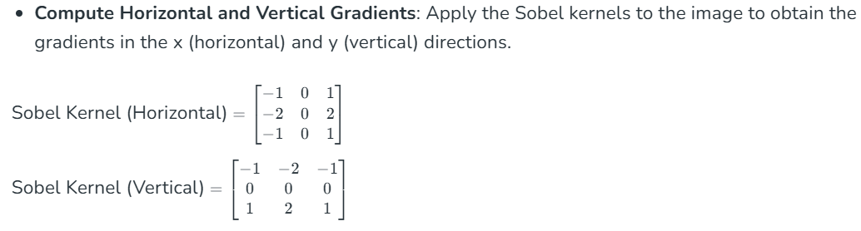
1. Sobel Operator
The Sobel operator computes the gradient of the image intensity at each point, giving the direction of the largest possible increase from light to dark and the rate of change in that direction.
It uses two 3x3 convolution kernels to calculate the gradient in the horizontal and vertical directions.

Slide 7
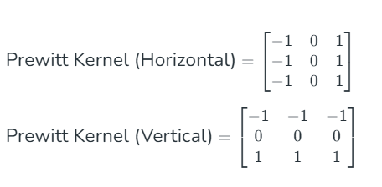
2. Prewitt Operator
The Prewitt operator calculates the gradient of the image intensity.
The main difference is in the convolution kernels used.

Slide 8
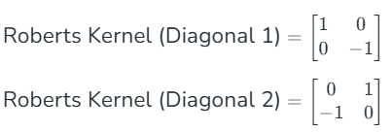
3. Roberts Cross Operator
The Roberts Cross operator performs a simple, quick-to-compute 2x2 gradient measurement on an image.
It emphasizes regions of high spatial frequency, which often correspond to edges.
Compute Diagonal Gradients: Apply the Roberts kernels to the image to obtain the gradients along the diagonals.

Slide 9
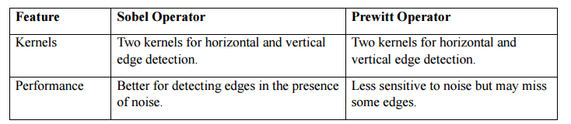
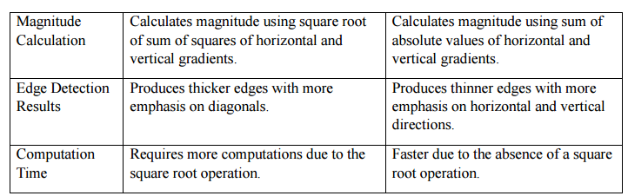
Compare Sobel and Prewitt Operators:
In general, the Sobel operator is more suitable for detecting edges in the presence of noise, while the Prewitt operator is less sensitive to noise but may miss some edges.

Slide 10

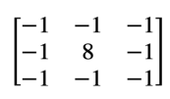
Laplace operator
The Laplacian operator is another commonly used edge detection algorithm in image processing.
It is a second-order derivative operator that calculates the Laplacian of the input image to detect edges.
The LaPlacian operator of an image f(x,y) is
This equation can be implemented using 3x3 mask as shown below:

Slide 11
The Laplacian operator Subtracts the brightness values of each of the neighbouring pixels
from the central pixel.
The Laplacian operator is rotationally invariant.
The Laplace operator is a powerful tool in image processing, but it has several drawbacks:
The Laplacian is a second-order derivative, making it highly sensitive to small variations in intensity.
The Laplacian filter can detect both positive and negative intensity transitions, often leading to
double edges instead of a single crisp boundary.
The Laplacian may shift edge positions slightly, especially when applied to complex structures or
textured images.

Slide 12
Zero Crossing
Zero crossings are an important concept in image processing and edge detection.
In the context of edge detection, a zero crossing is a point in an image where the intensity changes from positive to negative or vice versa, indicating the presence of an edge.
Zero crossings can be detected using the Laplacian operator or other second-order derivative operators.
After applying the Laplacian operator, the resulting filtered image is examined to identify regions where the intensity changes sign.
These regions are then marked as zero crossings, indicating the location of an edge in the image.

Slide 13
However, the Laplacian operator is sensitive to noise and may produce false positive zero crossings.
To address this, the filtered image can be further processed using techniques such as non-maximum suppression or thresholding to remove false positives and retain only the true zero crossings.
One of the main advantages of the zero-crossing operator is that it is relatively robust to noise, which is a common problem in image processing. The operator can detect edges even in images with high levels of noise, making it a useful tool in many real-world applications.
Another advantage of the zero-crossing operator is that it can be used to detect other features in an image besides edges. For example, it can be used to identify corners or blob-like structures by looking for clusters of zero crossings.

